Slide 1

Precision Farming
FarmWise Project

Slide 2
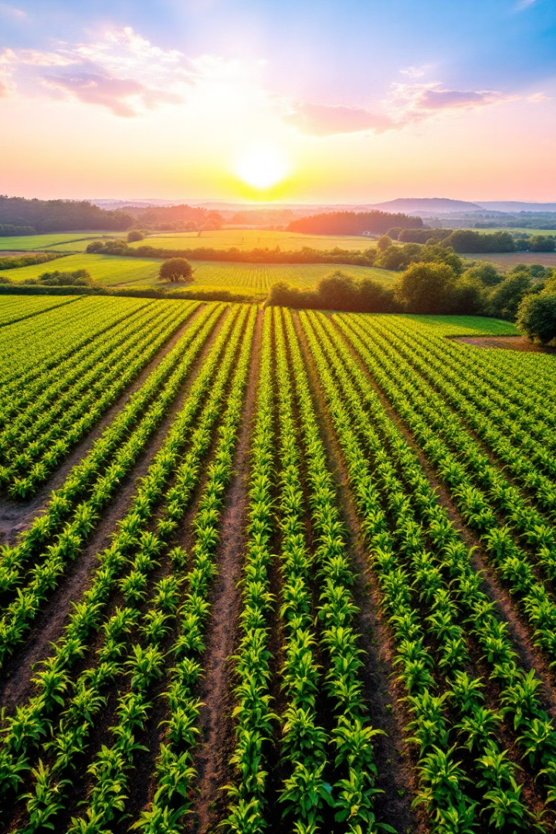
Precision Farming
Project Overview
This project aims to develop a simple yet effective website that utilizes AI, machine learning, and data analysis to assist farmers in making informed decisions about crop selection. The system will predict the best crops to plant on a piece of farmland based on soil test results or soil type and weather conditions. The website will serve as a user-friendly interface where farmers can input soil test data and receive AI-driven recommendations for optimal crop cultivation.
Precision farming uses data to optimize agricultural practices. This results in increased efficiency and reduced environmental impact.

Slide 3
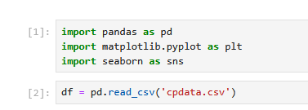
Objectives
Data Import and Packages
Provide insightful data analysis to improve precision farming.
Utilize machine learning algorithms to analyze soil data and recommend suitable crops.
Predict the most suitable crop based on environmental conditions like temperature, humidity, soil pH, and rainfall.
1
Package Installation
Import necessary libraries for data analysis and visualization.
2
Data import
Import data to be used for the project (‘cpdata.csv’)

Slide 4
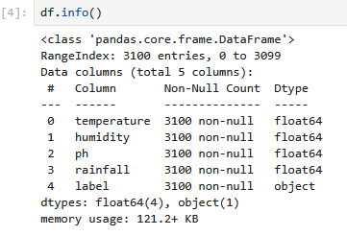


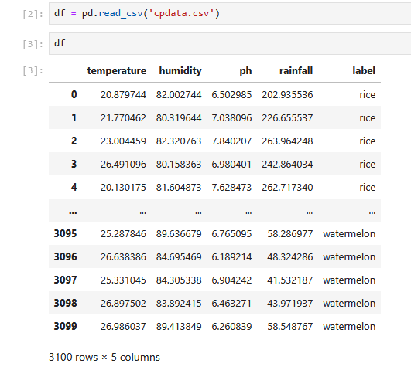


Exploration and Cleaning: Preparing for Analysis
Data Exploration
Understand the structure and characteristics of the data.
The data file contains 3,100 rows with 5 columns.
Label column is a categorical data indicating the crop type
(e.g., "rice"). There are 31 unique crop types.
Cleaning
No much cleaning was done on the data.
Transformation

Slide 5




Analysis and Discussion: Unveiling Insights
Statistical Modeling
Apply regression models to predict crop yields.
Spatial Analysis
Predict the most suitable crop based on environmental
conditions
Insight Generation
Identify key factors affecting crop performance.
Crop prediction highly influenced by rainfall and pH

Slide 6
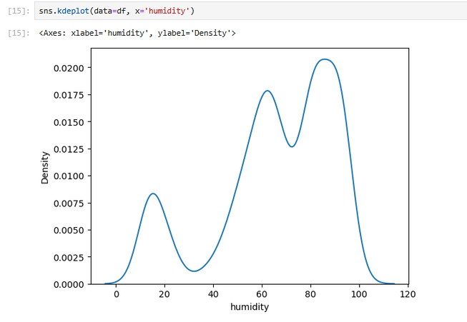
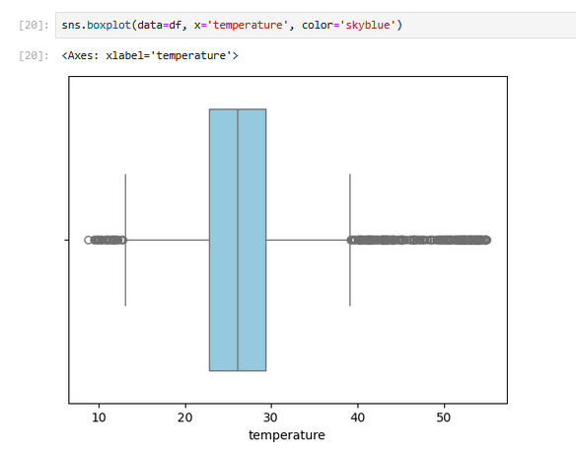
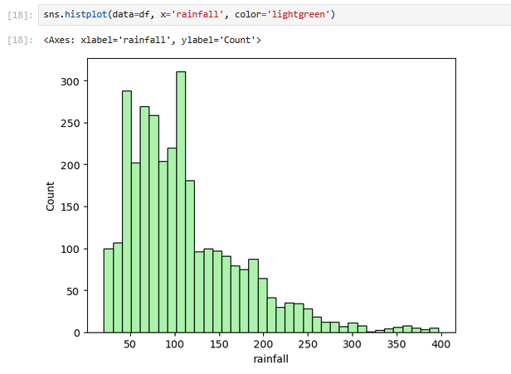
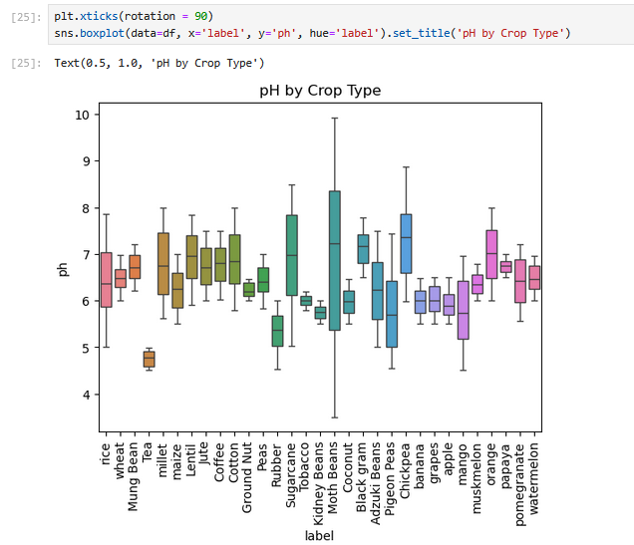
Univariate kdeplot
Univariate boxplot
Univariate histplot
Bivariate boxplot

Slide 7
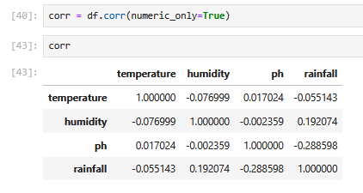
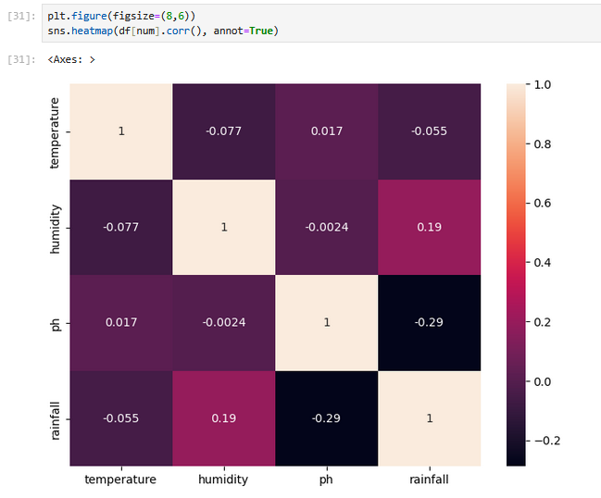
Correlation heatmap

Slide 8
Machine Learning
Data Exploration and Analysis
Data Gathering
MLPLC
(Machine learning project life cycle)
Evaluation
Data Cleaning
Algorithm Training
Data Preparation

Slide 9
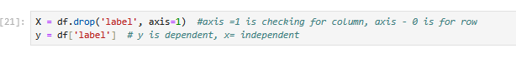
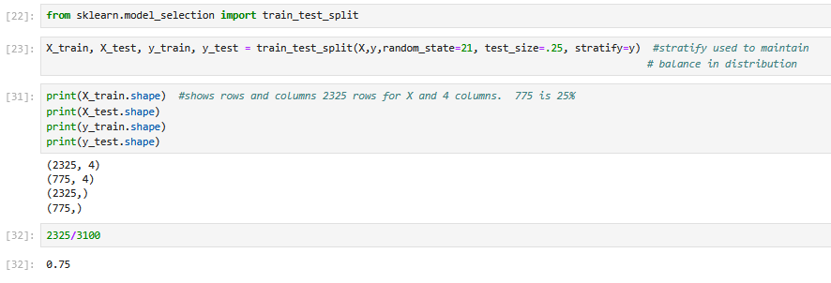
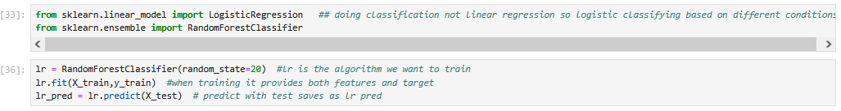
Machine Learning
Column Separation
Data Splitting
Splitting the data into training and test sets
Algorithms

Slide 10
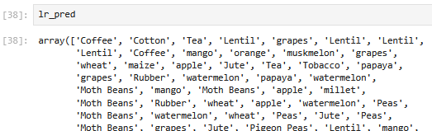
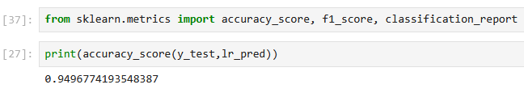
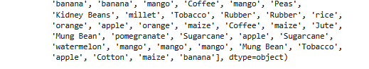
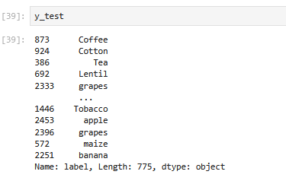
Algorithms continuation
Model Evaluation
We evaluated the model’s performance, which achieved an accuracy score of approximately 0.9496. So, our model is about 95% accurate

Slide 11
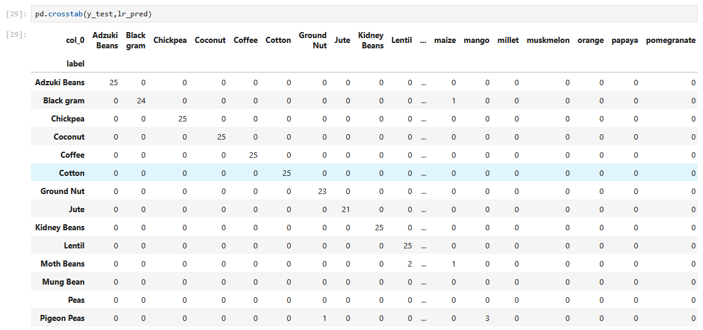
Crosstab showing accuracy of the predicted vs test

Slide 12
Conclusion
This project demonstrates how machine learning can be effectively used to recommend suitable crops based on environmental conditions.
By analyzing key features such as temperature, humidity, pH, and rainfall, the model achieves high accuracy (up to 95% accuracy score).
The solution has potential real-world applications in precision agriculture, empowering farmers to make informed crop decisions.

